Slide 1

Essential Oils and Personal Care
Notes:
Today we are going to talk about the benefits of using essential oils for personal care and how to use essential oils for skin, hair, oral care and many other hygiene needs. Whether you are an essential oil pro or just getting started, incorporating essential oils into your daily beauty or hygiene routine is an easy and wonderful way to use these gifts of the earth.

Slide 2
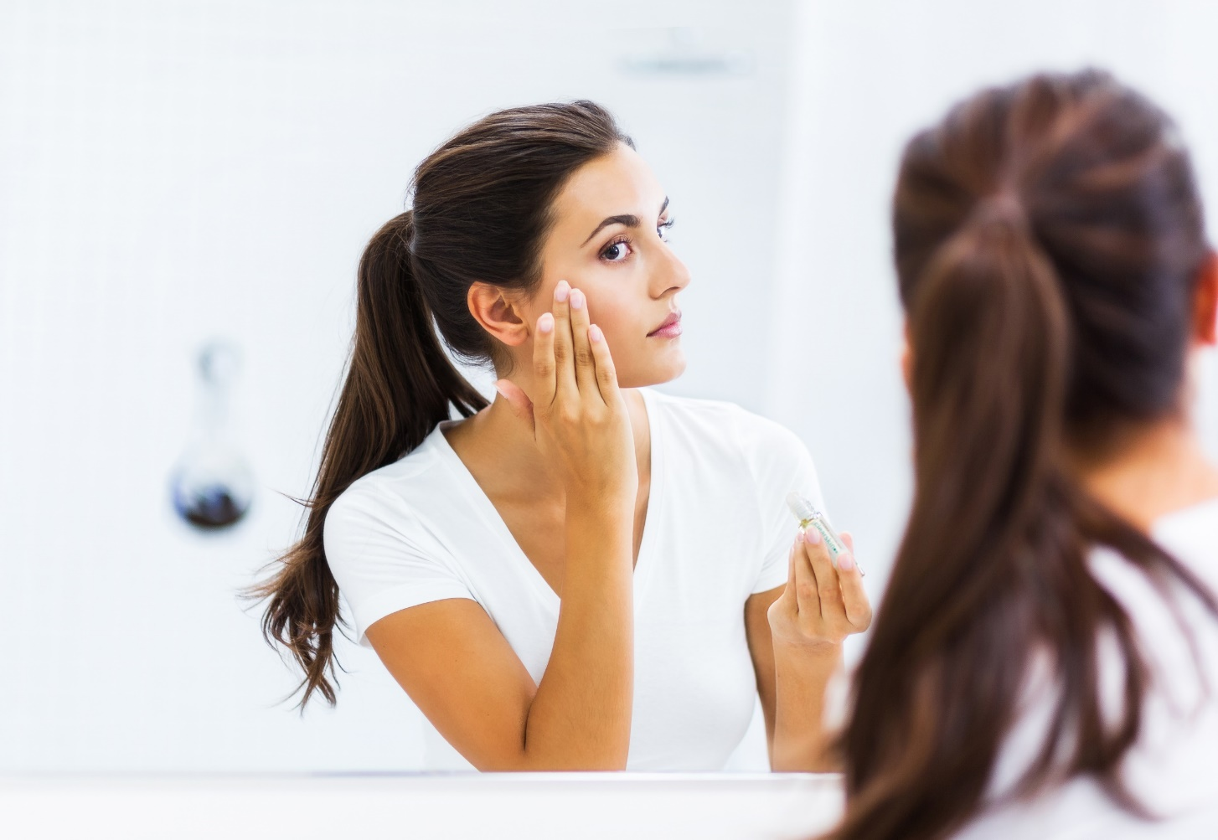
Using Essential Oils For
Personal Care
Beautifying skin and hair
Cleansing the mouth, teeth, and gums
General hygiene and beauty
Notes:
Each essential oil has its own set of unique chemical constituents that give the oil specific benefits. Many essential oils have powerful cleansing and purifying properties due to their chemical makeup, which makes them useful for maintaining clean skin. Other oils are naturally soothing and can be used topically on the skin to help soothe the occasional skin irritation or blemish. There are also several oils with special nurturing properties that can help moisturize or tone the skin, reduce the appearance of wrinkles and fine lines, or simply promote a healthy, glowing complexion. No matter your skin care needs, the unique and powerful nature of essential oils can help you care for your skin in a highly personal way.

Slide 3
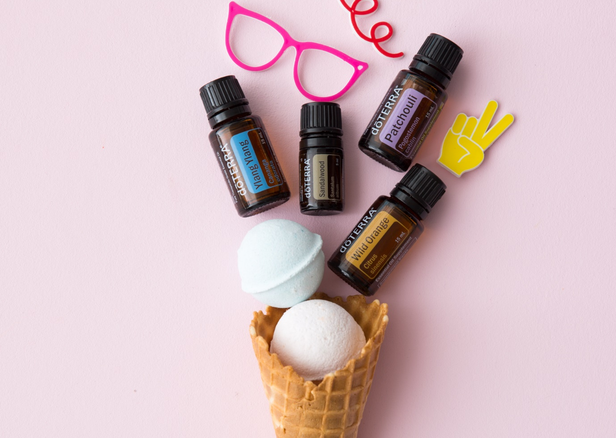
Why Use Essential Oils in a
Personal Care?
Pure, safe, non-toxic
Easy to incorporate into your daily routine
Simultaneously provides aromatic benefits
Notes:
Each essential oil has its own set of unique chemical constituents that give the oil specific benefits. Many essential oils have powerful cleansing and purifying properties due to their chemical makeup, which makes them useful for maintaining clean skin. Other oils are naturally soothing and can be used topically on the skin to help soothe the occasional skin irritation or blemish. There are also several oils with special nurturing properties that can help moisturize or tone the skin, reduce the appearance of wrinkles and fine lines, or simply promote a healthy, glowing complexion. No matter your skin care needs, the unique and powerful nature of essential oils can help you care for your skin in a highly personal way.

Slide 4
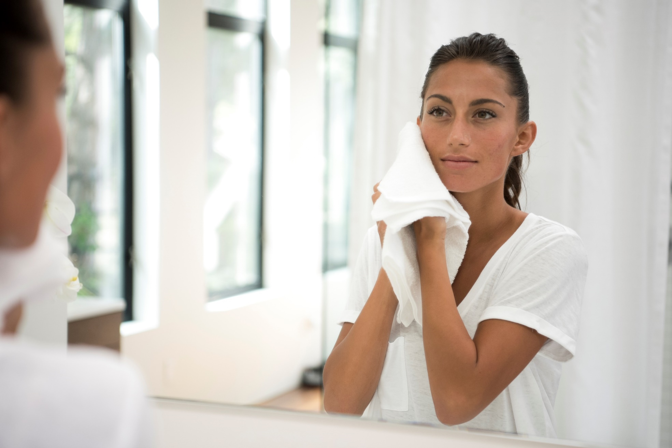
Essential Oils and Skin
Notes:
No matter your age or skin type, skin care is likely an integral part of your daily routine. Maintaining clean, healthy skin is an important part of good hygiene, and using essential oils during your daily skin care rituals can help support the kind of complexion you want. There are several properties that make essential oils useful for skin—including cleansing properties, soothing properties, and nurturing properties.

Slide 5

Benefits of Essential Oils for Skin
Cleansing and purifying properties
Soothing properties
Nurturing for the skin
Notes:
Each essential oil has its own set of unique chemical constituents that give the oil specific benefits. Many essential oils have powerful cleansing and purifying properties due to their chemical makeup, which makes them useful for maintaining clean skin. Other oils are naturally soothing and can be used topically on the skin to help soothe the occasional skin irritation or blemish. There are also several oils with special nurturing properties that can help moisturize or tone the skin, reduce the appearance of wrinkles and fine lines, or simply promote a healthy, glowing complexion. No matter your skin care needs, the unique and powerful nature of essential oils can help you care for your skin in a highly personal way.

Slide 6
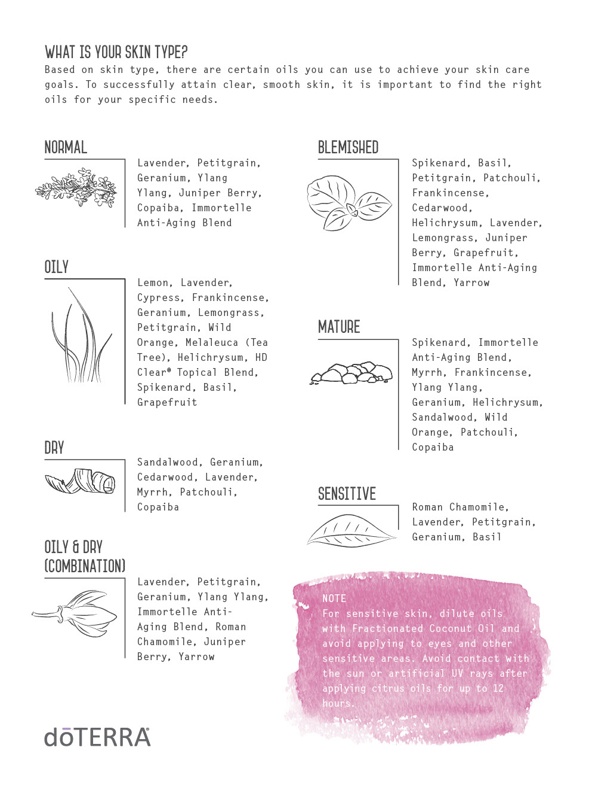
The Best Essential Oils for Skin
*For sensitive skin dilute oils with Fractionated Coconut Oil and avoid applying to eyes and other sensitive areas. Avoid sunlight or UV rays for up to 12 hours after applying citrus oils.
Notes:
As you start incorporating essential oils into your daily skin care routine, you will find that some oils are better for the skin than others. First, make sure that the oil you intend to use is approved for topical use. Then, consider the kind of benefits you want for your skin. Do you need moisture and hydration? Do you want to promote an even skin tone? Are you trying to get rid of a pesky blemish, or soothe an irritating area? With your goal in mind, you can choose an essential oil that will help you promote skin that looks and feels healthy.
This slide lists some of the best essential oils for skin, based on their chemical makeup. Bergamot oil is revered for its cleansing benefits, and can help purify the skin. The soothing nature of Lavender oil makes it useful for reducing the appearance of blemishes and skin imperfections. Essential oils like Frankincense and Patchouli have long been used for their beautifying properties, and can soothe the skin while promoting a glowing complexion. As you familiarize yourself with each essential oil and its benefits, you’ll be able to tailor the use of essential oils to fit your personal skin care preferences and needs.

Slide 7
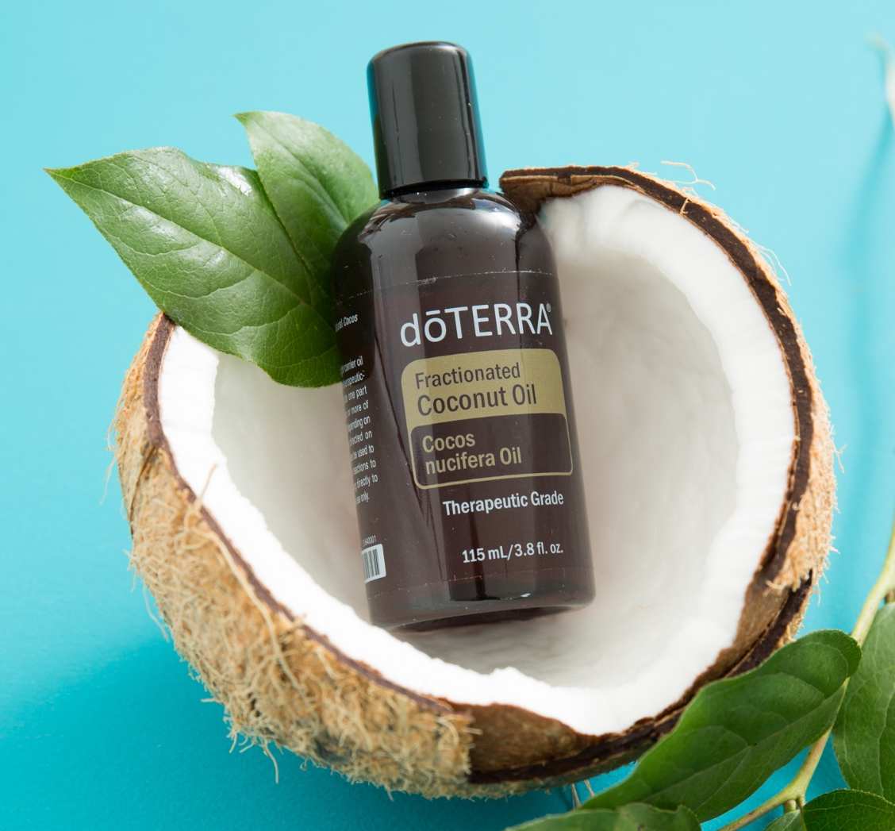
Tips for Essential Oils on Skin
Dilution: carrier oils, cleansers, moisturizers, etc.
Sensitive skin
Topical use with children
Avoid exposure to sun or UV rays for up to 12 hours when using citrus oils
Always dilute before using topically: Cassia, Cinnamon, Clove, Cumin, Oregano, Thyme
Notes:
Because the skin is such a sensitive, delicate part of the body, it is important to be aware of a few guidelines before incorporating essential oils into your skin care routine.
Topical use: As mentioned, you should always check to make sure that the oil you intend to use has been approved for topical use. Carefully read and examine the packaging and labeling of your essential oils to determine whether or not the product is safe for topical use.
Dilution: Once you’ve determined that the oil is safe to use topically, you will still want to consider whether you need to dilute the oil before use. If you have sensitive skin, or if you are using an essential oil with a particularly strong chemistry, you will want to dilute the oil before applying topically. You can easily dilute an essential oil before applying it to the skin by combining a drop of the oil with a few drops of a carrier oil, like dōTERRA Fractionated Coconut Oil. By combining the oil with a carrier oil, you can avoid irritation, while still experiencing the benefits that oil has to offer.
You can also dilute an essential oil by placing a drop or two into a bottle of your favorite facial cleanser, moisturizer, lotion, or skin care product. The oil will be diluted by the rest of the product, and will be automatically applied to your skin each time you use the product to wash your face or moisturize your skin.
Sensitive skin: If you have sensitive skin, it is typically a good idea to always dilute an essential oil before applying it to the skin. This will lower your risk for irritating the skin, while still allowing you to experience the beautifying effects of the oil. Some people worry that diluting an oil will reduce its effectiveness; however, combining an essential oil with a carrier oil actually increases absorption into the skin—allowing the user to experience the full benefits of the oil for an extended period of time.
Topical use with children: Because children’s skin is delicate and sensitive, it is important to alter application methods before using essential oils topically on your children. When using essential oils with children, it is always a good idea to dilute the oil. And remember, you will need far less oil for a child than you will for an adult.
Avoid sun/UV exposure: It is important to be aware that some essential oils, particularly citrus oils, can cause irritation in the skin when exposed to the sun or UV lights. When applying oils like Bergamot or Grapefruit to the skin, make sure to avoid sun exposure, or exposure to UV lights (like tanning beds) for up to 12 hours after you apply the oil. An easy way to avoid this kind of irritation is to apply the oil at night, allowing it to work on the skin while you sleep, and then washing it off in the morning.
Always dilute: As mentioned, you should always dilute when using an oil that has a particularly strong chemistry. Cassia, Cinnamon, Clove, Cumin, Geranium, Oregano, and Thyme essential oils should always be diluted before topical use due to their chemical makeup.

Slide 8
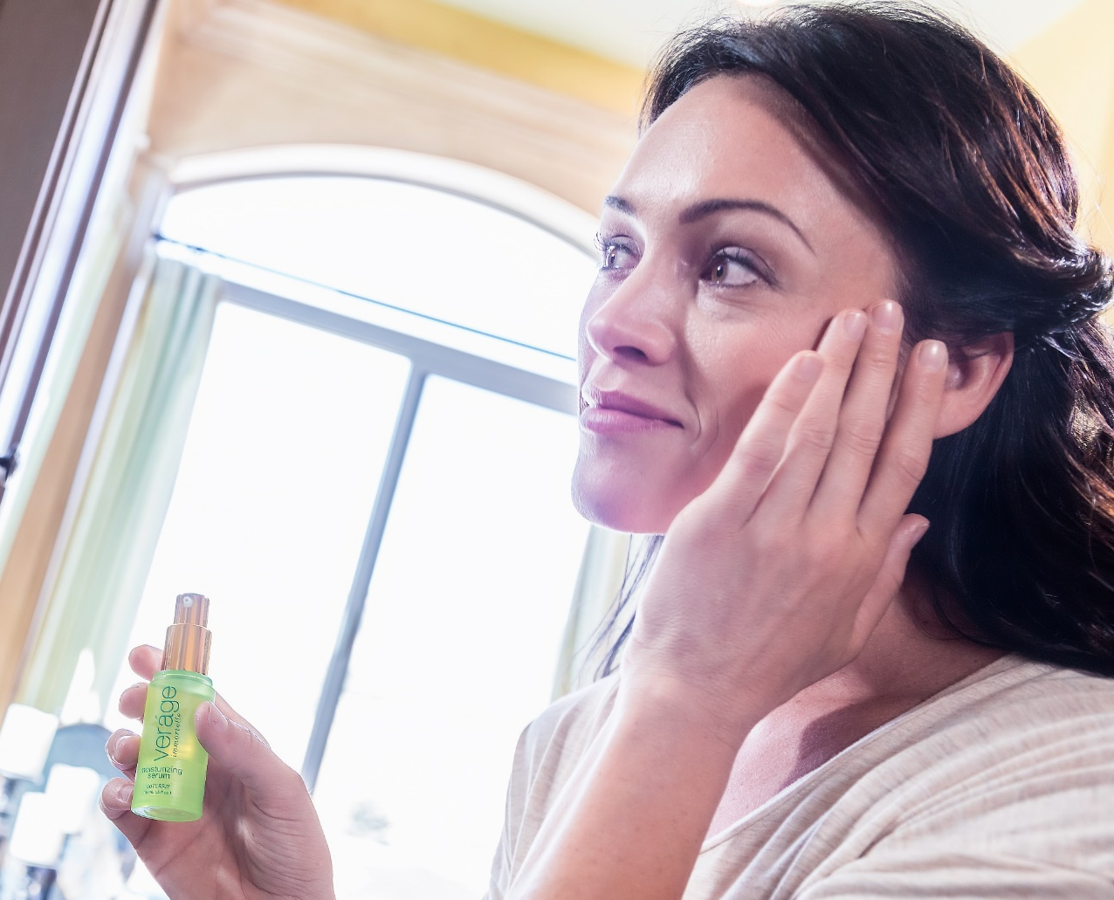
Using Essential Oils in Your Skin
Care Routine
Cleanse and purify the skin
Reduce the appearance of blemishes and imperfections
Promote a healthy-looking complexion
Notes:
Because the skin is such a sensitive, delicate part of the body, it is important to be aware of a few guidelines before incorporating essential oils into your skin care routine.
Topical use: As mentioned, you should always check to make sure that the oil you intend to use has been approved for topical use. Carefully read and examine the packaging and labeling of your essential oils to determine whether or not the product is safe for topical use.
Dilution: Once you’ve determined that the oil is safe to use topically, you will still want to consider whether you need to dilute the oil before use. If you have sensitive skin, or if you are using an essential oil with a particularly strong chemistry, you will want to dilute the oil before applying topically. You can easily dilute an essential oil before applying it to the skin by combining a drop of the oil with a few drops of a carrier oil, like dōTERRA Fractionated Coconut Oil. By combining the oil with a carrier oil, you can avoid irritation, while still experiencing the benefits that oil has to offer.
You can also dilute an essential oil by placing a drop or two into a bottle of your favorite facial cleanser, moisturizer, lotion, or skin care product. The oil will be diluted by the rest of the product, and will be automatically applied to your skin each time you use the product to wash your face or moisturize your skin.
Sensitive skin: If you have sensitive skin, it is typically a good idea to always dilute an essential oil before applying it to the skin. This will lower your risk for irritating the skin, while still allowing you to experience the beautifying effects of the oil. Some people worry that diluting an oil will reduce its effectiveness; however, combining an essential oil with a carrier oil actually increases absorption into the skin—allowing the user to experience the full benefits of the oil for an extended period of time.
Topical use with children: Because children’s skin is delicate and sensitive, it is important to alter application methods before using essential oils topically on your children. When using essential oils with children, it is always a good idea to dilute the oil. And remember, you will need far less oil for a child than you will for an adult.
Avoid sun/UV exposure: It is important to be aware that some essential oils, particularly citrus oils, can cause irritation in the skin when exposed to the sun or UV lights. When applying oils like Bergamot or Grapefruit to the skin, make sure to avoid sun exposure, or exposure to UV lights (like tanning beds) for up to 12 hours after you apply the oil. An easy way to avoid this kind of irritation is to apply the oil at night, allowing it to work on the skin while you sleep, and then washing it off in the morning.
Always dilute: As mentioned, you should always dilute when using an oil that has a particularly strong chemistry. Cassia, Cinnamon, Clove, Cumin, Geranium, Oregano, and Thyme essential oils should always be diluted before topical use due to their chemical makeup.

Slide 9
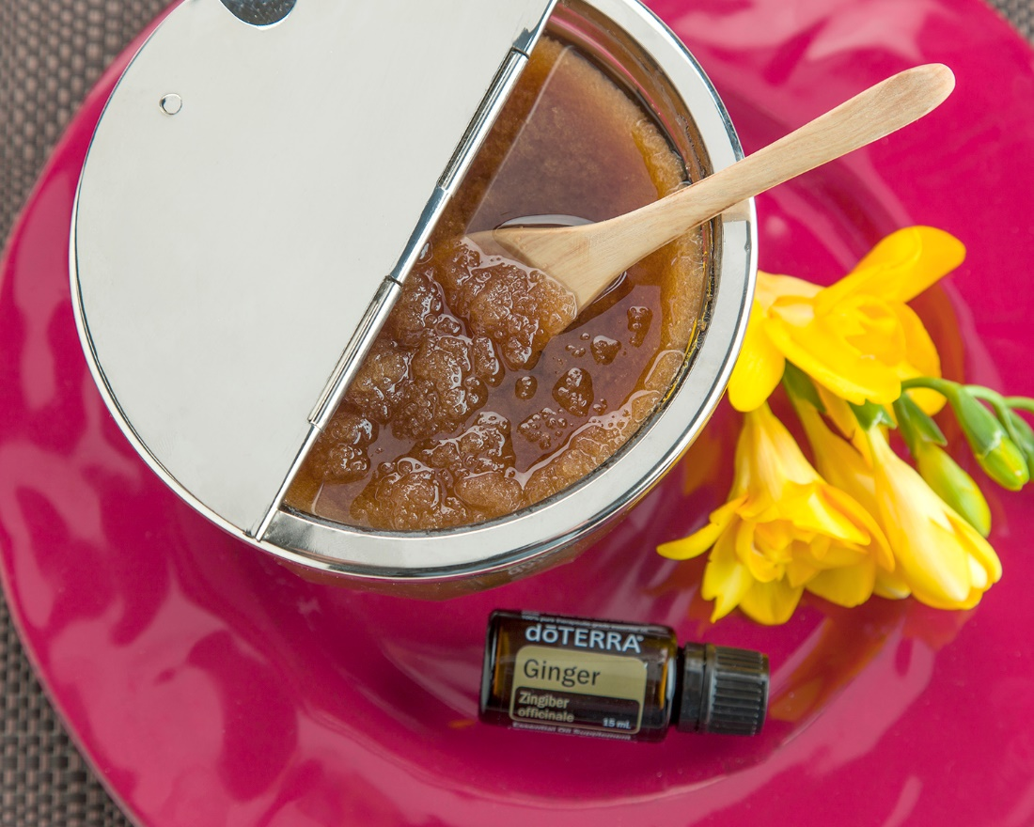
Lime Ginger Brown Sugar Scrub
Ingredients:
½ cup brown sugar
½ cup dōTERRA Fractionated Coconut Oil
10 drops Lime oil
5 drops Ginger oil
Directions:
Combine brown sugar, Fractionated Coconut Oil, and essential oils in medium-sized bowl and stir. Apply to hands, arms, legs, or feet, and scrub until sugar dissolves. Rinse with warm water and pat dry.
Notes:
Discuss the DIY on this slide with the audience. Consider printing out this recipe for the class members to take home with them. If you have a small enough group, consider making the scrub beforehand and letting the class members try it by rubbing it on their hands and washing it off.

Slide 10
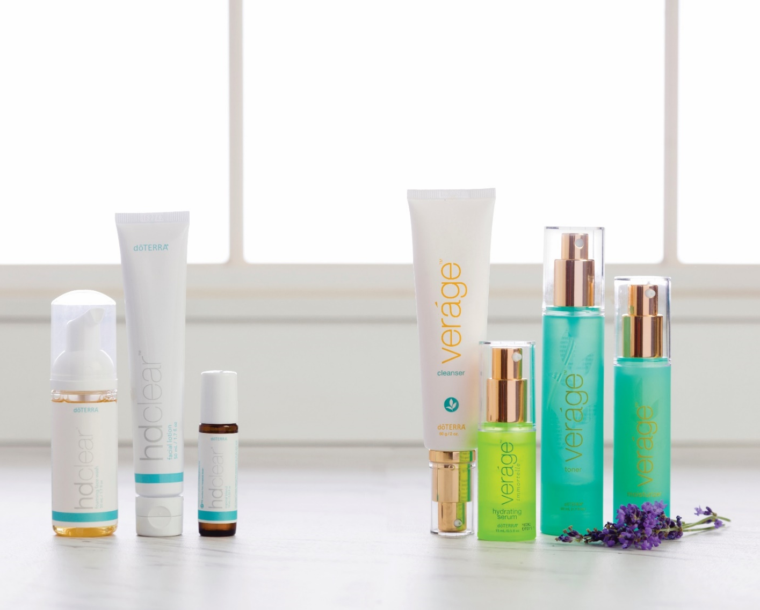
dōTERRA Skin Care Products
Veráge
HD Clear
Essential Skin Care
dōTERRA SPA
®
®
Notes:
In addition to using single essential oils in your skin care routine, you can also access the benefits of essential oils for skin by using skin care products that already have essential oils in them. dōTERRA has several skin care collections and products that use pure essential oils and some of the best extracts and ingredients on earth to help beautify the skin.
Veráge®: A collection of natural skin care products that are designed to hydrate and nourish the skin while reducing the signs of aging. The Veráge collection includes the Veráge Cleanser, the Veráge Immortelle Hydrating Serum, the Veráge Moisturizer, and the Veráge toner.
HD Clear®: Designed to promote clear skin and a smooth complexion by using CPTG® essential oils. While it is appropriate for all ages, HD Clear is a wonderful skin care solution for teenagers and young adults who are struggling with skin issues. The HD Clear product line includes the HD Clear Foaming Face Wash, HD Clear Topical Blend, and HD Clear Lotion.
Essential Skin Care: This collection combines the power of essential oils and plant extracts to promote clean, healthy-looking skin. The products in the Essential Skin Care line include the Anti-Aging Moisturizer, Facial Cleanser, Hydrating Cream, Invigorating Scrub, Pore Reducing Toner, Tightening Serum, and the Reveal Facial System.
dōTERRA® SPA: With special essential oil formulas, the products in the dōTERRA SPA collection are designed to give you a luxurious spa experience from the comfort of your own home. This collection includes products like the dōTERRA® SPA Detoxifying Mud Mask, dōTERRA® SPA Exfoliating Body Scrub, dōTERRA® SPA Refreshing Body Wash, dōTERRA® SPA Replenishing Body Butter, dōTERRA® SPA Moisturizing Bath Bar, dōTERRA® SPA Lip Balm, dōTERRA® SPA Rose Hand Lotion and more.
Introduce the audience to each of the dōTERRA® skin care lines on this slide (Verage®, HD Clear®, Essential Skin Care and dōTERRA® SPA). Talk about any product lines or specific products you have used, and share any personal experiences you have had with these products.

Slide 11
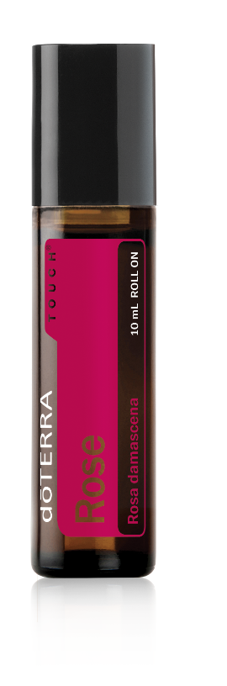
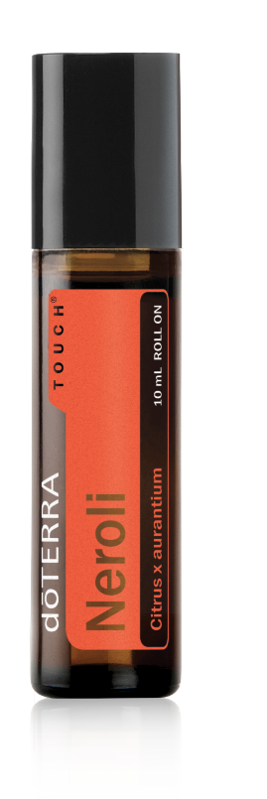
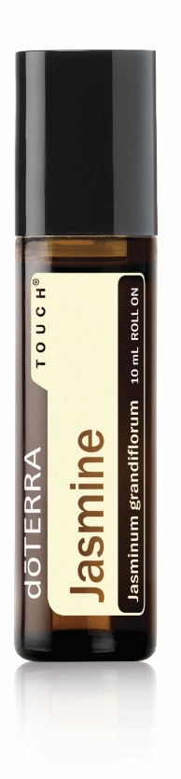
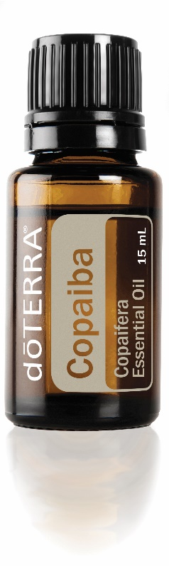
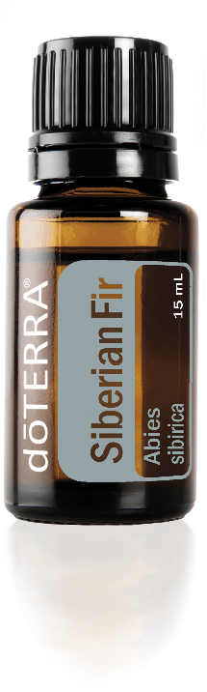
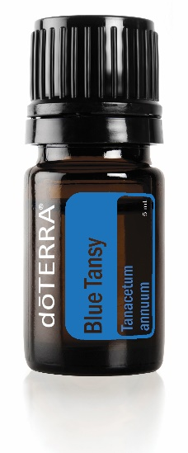
NEW Essential Oils that are
Perfect for Skin
Blue Tansy
Copaiba
Jasmine Touch
Neroli Touch
Rose Touch
Notes:
At dōTERRA’s 2017 “You” Convention, dōTERRA released several new products, including a few unique essential oils that have benefits for the skin. With soothing, purifying, and nourishing benefits, these are a few oils that you’ll want to put on your wish list:
Blue Tansy: With a distinct fruity balsamic aroma, Blue Tansy oil provides the skin with a soothing sensation when applied topically. This oil can also help to reduce the appearance of blemishes, so it is a good one to add to your daily moisturizers or cleansers.
Copaiba: Not only does Copiaba oil provide a comforting, warm and woody aroma, but this oil is known to promote clear, smooth skin while helping to reduce the appearance of blemishes. Consider combining Copaiba with dōTERRA Fractionated Coconut Oil and applying to the skin for a clear, clean complexion.
Jasmine Touch: If you’ve ever used Jasmine essential oil, you know that it holds serious benefits for the skin, not to mention, it has one of the most inviting floral scents of any essential oil. Now dōTERRA has made it even easier to enjoy the benefits of Jasmine oil with dōTERRA Jasmine Touch. This product is easy to apply, and comes pre-diluted with dōTERRA Fractionated Coconut Oil for those with sensitive or delicate skin. You can even keep this roll-on bottle in your purse to help reduce the appearance of skin imperfections on-the-go.
Neroli Touch: The refreshing, citrus aroma of Neroli oil is definitely one that you won’t mind lingering on your skin all day. This oil has soothing properties for the skin and can help to improve the appearance of blemishes. Neroli Touch also promotes a positive mood, so you can benefit from its uplifting aroma anytime you apply it to the skin.
Rose Touch: If you want to promote an even skin tone and glowing complexion, the new Rose Touch roller bottle should be a part of your essential oil collection. Not only will this oil help to improve the appearance of skin imperfections, but it will leave you smelling like a rose for several hours. Just like Jasmine Touch and Neroli Touch, the Rose Touch oil comes pre-diluted with dōTERRA Fractionated Coconut Oil to make topical application even easier.

Slide 12

Essential Oils and Hair Care
Notes:
Just as essential oils are useful for cleansing and beautifying the skin, they can be used to cleanse, nourish, and fortify the hair. Useful for promoting a healthy scalp, supporting soft, shiny hair, and making your hair smell amazing, essential oils are easy to incorporate into your daily hair care routine.

Slide 13
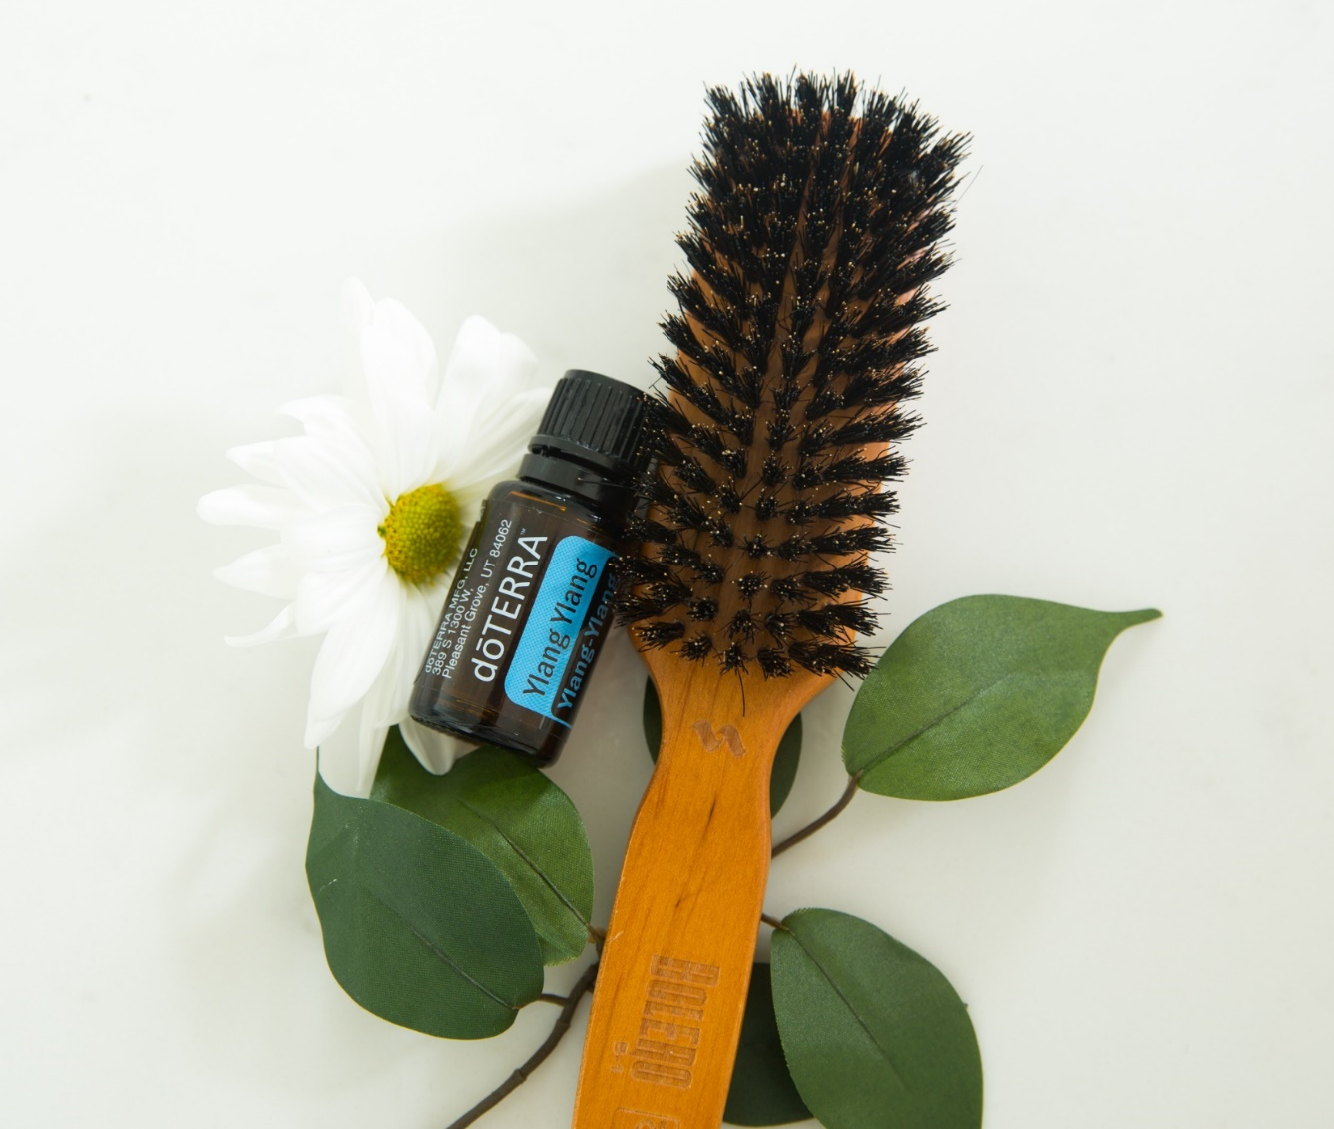
Benefits of Essential Oils for Hair
Cleansing properties
Nourishing and fortifying
Promoting a healthy scalp
Notes:
As mentioned, the same chemical properties that make essential oils useful for cleansing and purifying the skin also make them useful for cleaning the hair and scalp. Essential oils can be extremely useful during your haircare routine because they will provide the head and hair with a refreshed, clean feeling.
In addition to cleansing the hair and scalp, essential oils can also be nourishing for hair strands due to their soothing properties. Essential oils can help promote soft, shiny hair, while helping nourish and maintain healthy-looking strands.
Lastly, essential oils are very useful for cleansing and fortifying the scalp. Essential oils are frequently used in scalp massages—not only because of their inviting aroma, but because they have beneficial properties that will help keep the scalp looking and feeling clean.

Slide 14
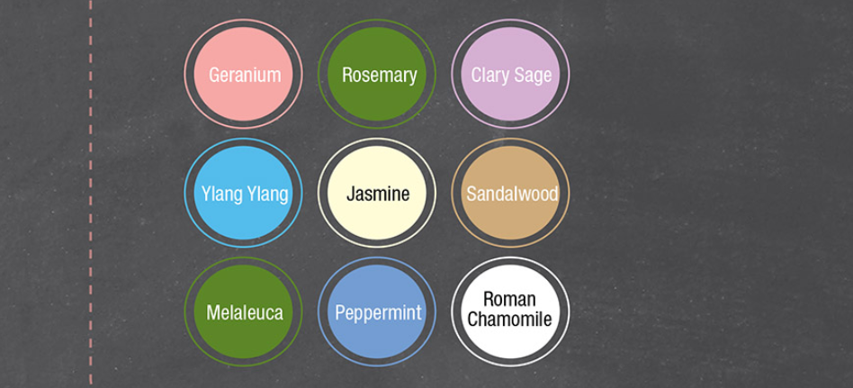
The Best Essential Oils
for Hair and Scalp
Notes:
When using essential oils in your hair care routine, it is best to choose oils with cleansing, soothing, and beautifying properties. Plus, you want to choose an oil with an aroma that you like, since the scent of the oil will remain on your hair after application. The essential oils on this slide are some of the best oils for hair due to their cleansing and soothing nature. Any of these essential oils can also be used during a scalp massage to help promote a healthy, clean scalp.

Slide 15
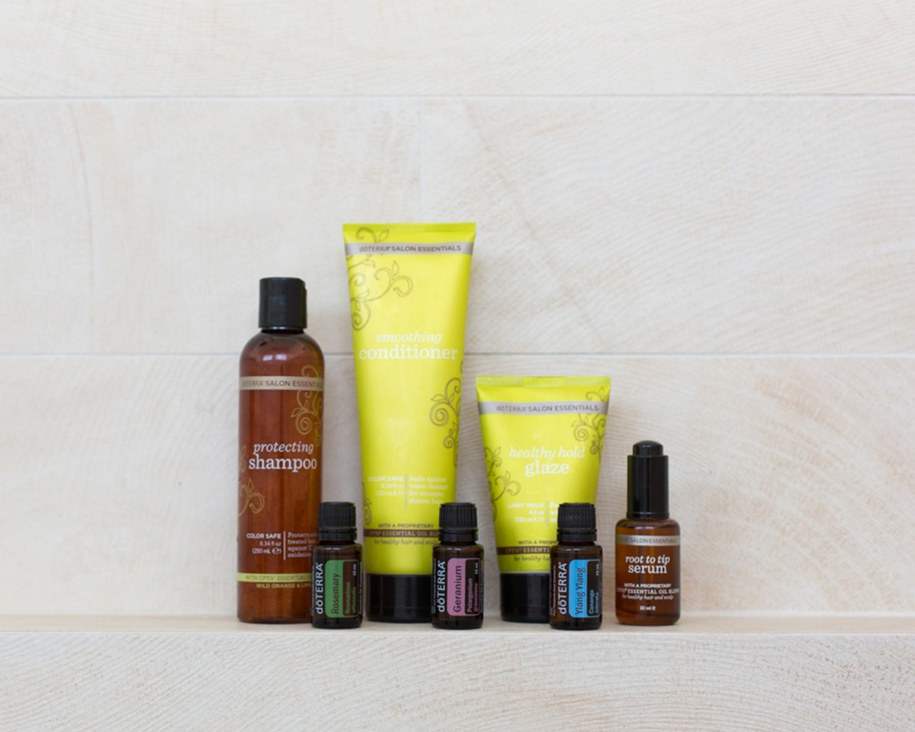
Using Essential Oils
in a Daily Hair Routine
Add oils to shampoo and conditioners
Combine essential oils with water in a spray bottle and spritz on hair
Use essential oils to promote a healthy scalp
Notes:
Once you’ve chosen an essential oil that will benefit the hair, there are several ways to incorporate the oil into your daily hair care routine. One of the easiest ways to enjoy the benefits of essential oils for hair is to add a few drops of the oil to your shampoo or conditioner. By infusing your favorite shampoos and conditioners with essential oils, you can easily nourish, cleanse, and beautify your hair without any extra effort.
To promote smooth, shiny strands, you can also combine a few drops of an essential oil with a few ounces of water in a spray bottle and spritz on the ends of the hair. Remember, using too much of an essential oil in the hair (particularly at the roots) can make the hair feel and look oily. Only a small amount of oil will be needed to help promote silky, healthy-looking hair.
As discussed, essential oils can be very useful for promoting a healthy scalp. To help maintain a healthy scalp and an abundant-looking head of hair, massage essential oils into the scalp for five to ten minutes, once or twice a week. Again, you won’t need a large amount of oil to experience the benefits. The best time to do this is right before you go to bed—massage the oil into the head and scalp, and wash the oil out in your shower the next morning so that your hair doesn’t look oily or greasy.
Discuss with the audience any of your favorite ways to use essential oils for hair.
In addition to these applications, essential oils can be useful for hair DIYs.

Slide 16
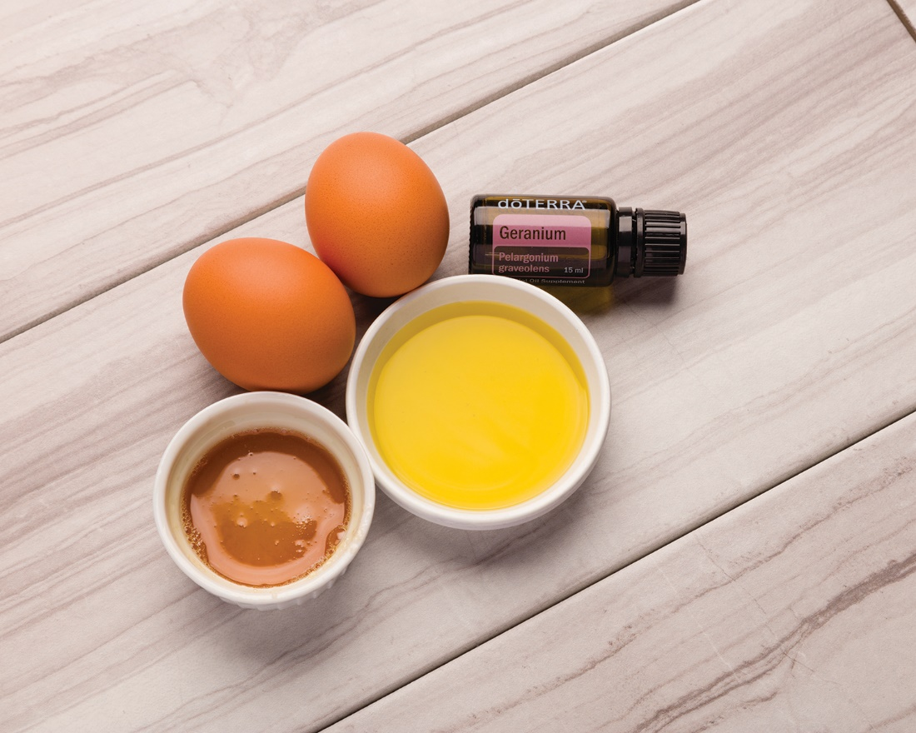
Geranium Hair Mask
Ingredients:
2 eggs
1 tablespoon honey
1 tablespoon olive oil
5 drops Geranium oil
Directions:
Mix eggs with olive oil. Add honey and Geranium oil and mix until creamy. Apply mask from roots to ends until completely covered. Cover hair with plastic wrap or shower cap for 30 minutes. Rinse with warm water and shampoo.
Notes:
Discuss the DIY on this slide with the audience. Consider printing off this DIY recipe so that class members can take it home and try it themselves. If you have a small class size, consider making this hair mask beforehand, placing in small containers, and giving each member of the class a small amount of the hair mask to take home and try on their own.
For More Essential Oil Hair DIYs:
https://www.doterra.com/US/en/blog/diy-roundup-essential-oils-for-hair

Slide 17
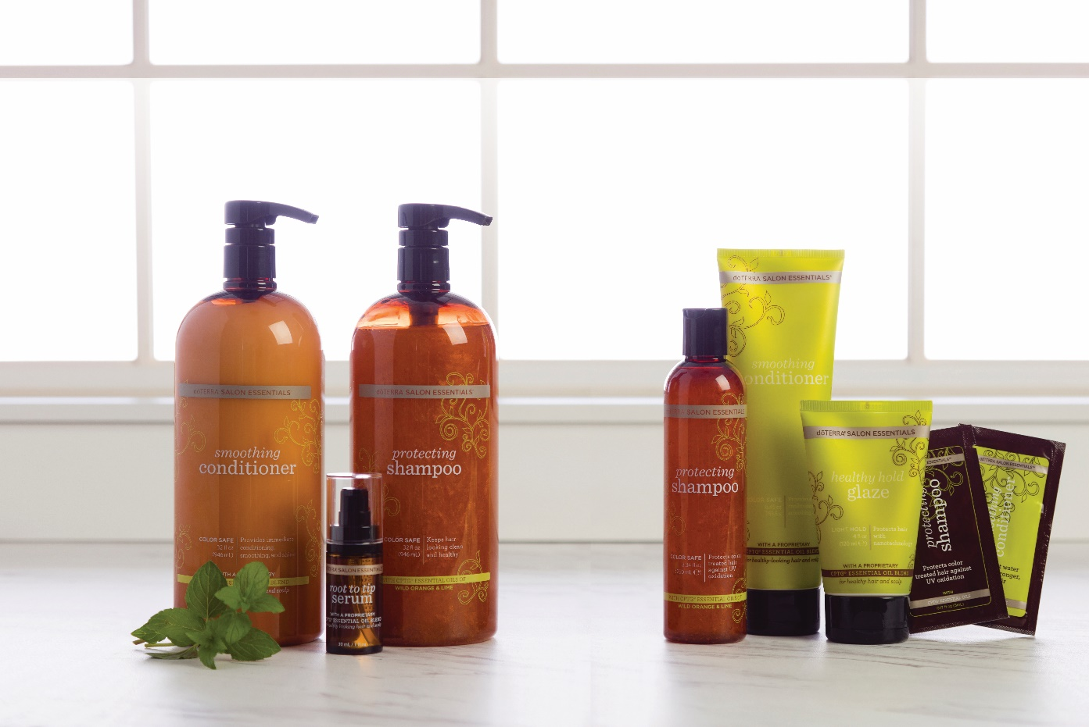
®
dōTERRA Salon Essentials
Protecting Shampoo
Smoothing Conditioner
Healthy Hold Glaze
Root to Tip Serum
Notes:
Along with using single essential oils to care for your hair, you can also try some of dōTERRA’s essential oil–infused hair care products from the dōTERRA Salon Essentials collection. Go over the products in the dōTERRA Salon Essentials collection and talk with the audience about your favorite products, or any personal experiences you have had with this product line.

Slide 18

Essential Oils and Oral Care
Notes:
In addition to skin care and hair care, oral care is an important part of good hygiene. As you might have guessed, the same chemical components that make essential oils useful for cleansing and soothing your skin and hair, also make them helpful for maintaining healthy teeth and gums. Because of their powerful purifying and soothing properties, essential oils are frequently used in oral hygiene products like toothpaste, mouthwash, or gum. Just as you can easily transform your skin care and hair care routine with essential oils, you will experience a variety of benefits by adding essential oils to your daily oral care routine.

Slide 19
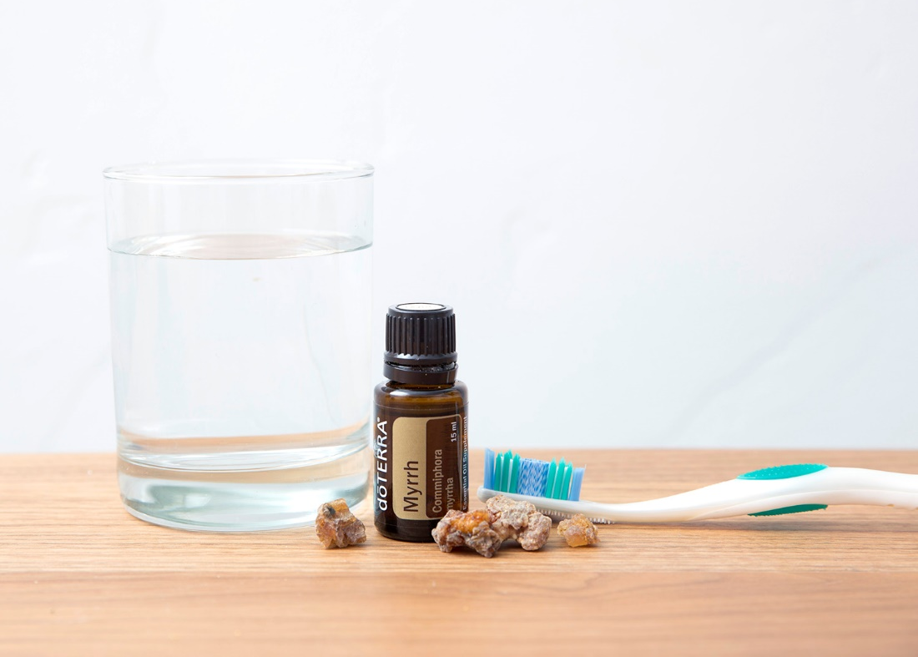
Benefits of Essential Oils
in Oral Hygiene
Cleansing the teeth, gums,
and mouth
Promoting fresh breath
Promoting healthy teeth and mouth
Notes:
Because they hold such powerful cleansing properties, one of the major benefits of using essential oils in oral care is that they can help keep the mouth, teeth, and gums clean. A clean mouth is the key to good oral hygiene, and essential oils can make it easy to cleanse the mouth in just a few minutes.
Along with promoting clean teeth and gums, essential oils can be helpful for promoting fresh breath. Using refreshing essential oils like Peppermint, Spearmint, or Cinnamon can help promote fresh breath throughout the day.
By using essential oils in your regular oral care routine, you can help promote healthy teeth and gums, which will support a healthy mouth overall.

Slide 20

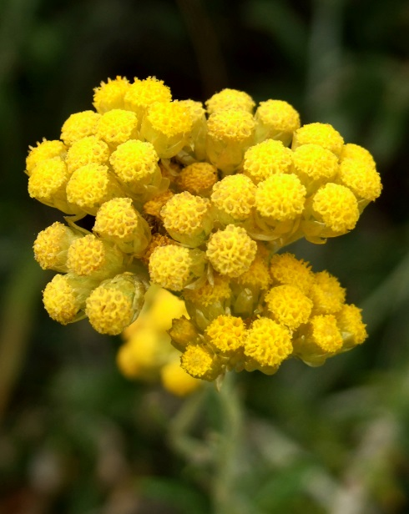
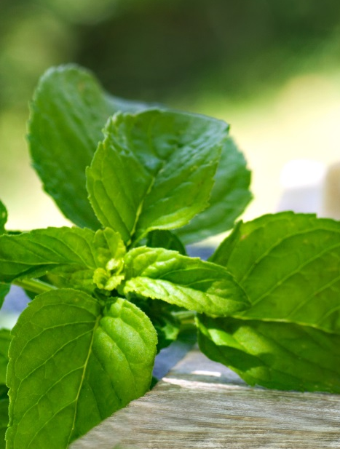
The Best Essential Oils
for Oral Hygiene
Clove
Cinnamon
Cilantro
Coriander
Fennel
Frankincense
Helichrysum
Juniper Berry
Lime
Peppermint
Spearmint
Notes:
When selecting essential oils for oral care, it is important to choose cleansing, refreshing oils that have been approved for topical and internal use. Because the oils will be in your mouth, it is important to choose oils that don’t pose a threat if they are ingested. The essential oils on this slide are some of the best oils for oral care because they are cleansing, soothing, and refreshing.

Slide 21

Tips for Using Essential Oils
in Oral Hygiene
Dilution
Sensitivities
Children
Notes:
Each essential oil has its own set of unique chemical constituents that give the oil specific benefits. Many essential oils have powerful cleansing and purifying properties due to their chemical makeup, which makes them useful for maintaining clean skin. Other oils are naturally soothing and can be used topically on the skin to help soothe the occasional skin irritation or blemish. There are also several oils with special nurturing properties that can help moisturize or tone the skin, reduce the appearance of wrinkles and fine lines, or simply promote a healthy, glowing complexion. No matter your skin care needs, the unique and powerful nature of essential oils can help you care for your skin in a highly personal way.

Slide 22
Using Essential Oils
in Daily Oral Care
Add oils to toothbrush or toothpaste
Essential Oil Mouthwash
  1 drop Spearmint oil
  2 oz. water
  1 drop Cinnamon oil
  2 oz. water
  1 drop Eucalyptus
  1 drop Lemon
  2 oz. water
Notes:
Each essential oil has its own set of unique chemical constituents that give the oil specific benefits. Many essential oils have powerful cleansing and purifying properties due to their chemical makeup, which makes them useful for maintaining clean skin. Other oils are naturally soothing and can be used topically on the skin to help soothe the occasional skin irritation or blemish. There are also several oils with special nurturing properties that can help moisturize or tone the skin, reduce the appearance of wrinkles and fine lines, or simply promote a healthy, glowing complexion. No matter your skin care needs, the unique and powerful nature of essential oils can help you care for your skin in a highly personal way.

Slide 23
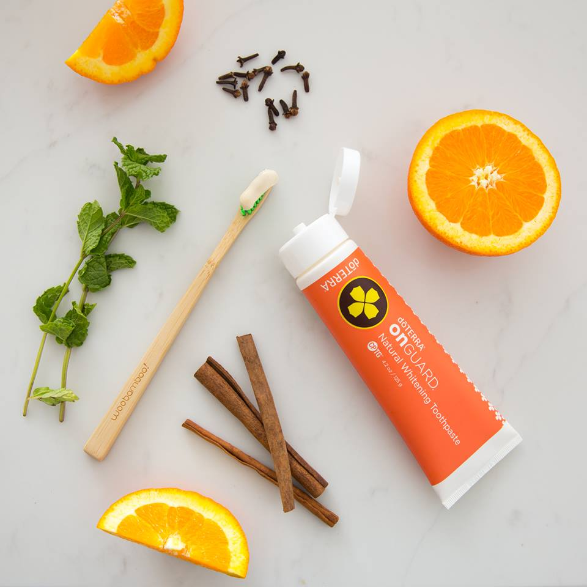
dōTERRA Oral Hygiene Products
dōTERRA On Guard® Natural Whitening Toothpaste
Peppermint beadlets
Notes:
For an even easier way to incorporate essential oils into your oral hygiene routine, you can use the dōTERRA On Guard® Natural Whitening Toothpaste to cleanse the mouth, or Peppermint beadlets to freshen the breath.
Discuss each of these products with the audience. Describe any personal experiences you’ve had while using the dōTERRA On Guard Whitening Toothpaste or Peppermint beadlets. Tell the class members about any of your favorite methods for using essential oils for oral care.

Slide 24
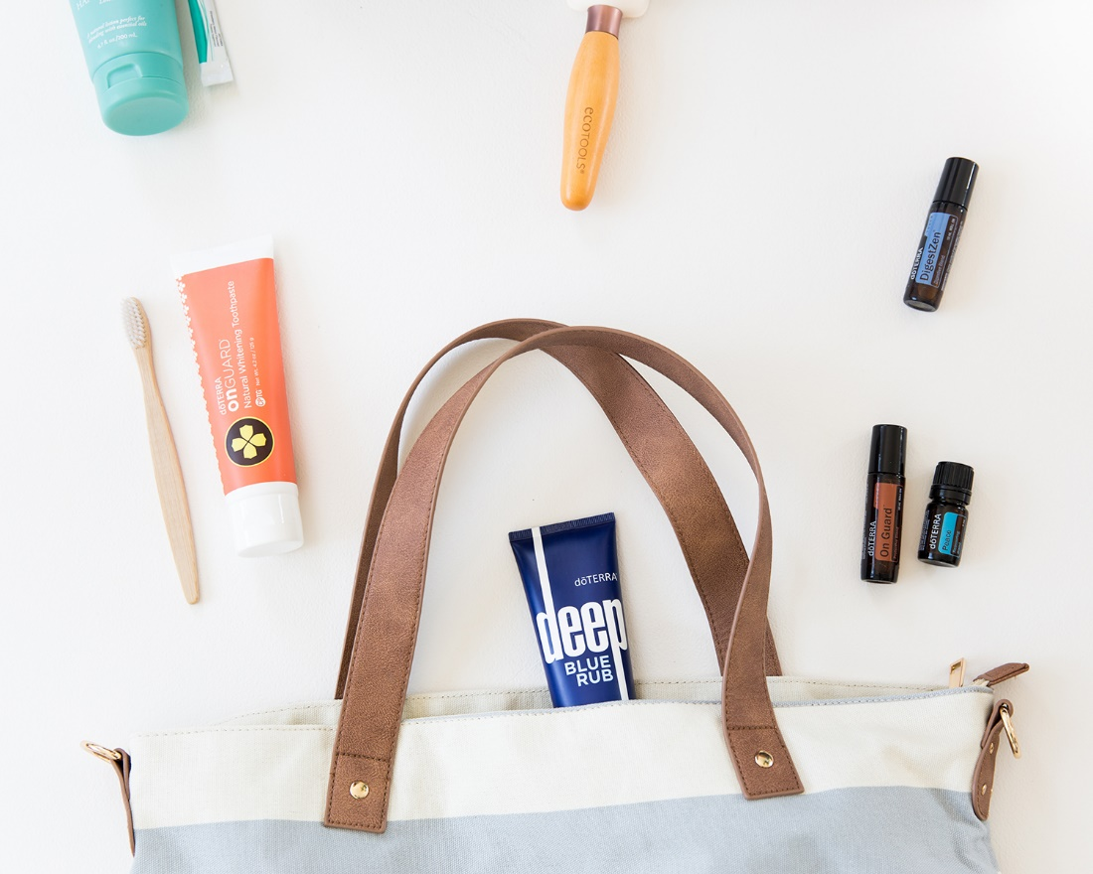
Other Ideas For Using Essential Oils
During Your Daily Hygiene Routine
Showering and bathing
Shaving
Deodorant, perfume, and cologne
Fingernails and toenails
Notes:
While essential oils can be used for skin, hair, and oral care, their variety of benefits makes them useful for other hygienic tasks too.
Showering and bathing: You can use essential oils in your daily shower to invigorate or energize your day. Simply choose an essential oil, (oils like Bergamot, White Fir, and Eucalyptus work well), and place a few drops of the oil on the floor of the shower (away from the water path.) As you shower, you will breathe in the energizing, uplifting, or invigorating aroma of the oil.
You can enhance your bath experience by adding a few drops of oil to a warm bath. Oils like Myrrh, Roman Chamomile, Frankincense, and Lavender can help provide a luxurious aromatic experience during bath time. You can also add a few drops of an essential oil (or several oils) to some Epsom bath salts to further enhance your experience.
Consider making essential oil bath salts that audience members can take home and try for themselves. Here is a simple recipe:
Essential Oil Bath Salts
with dōTERRA® essential oils
Ingredients
1 cup Epsom salt
10 drops of dōTERRA essential oil (use an essential oil with relaxing or soothing properties, or with benefits for the skin)
Directions
1. Add 10 drops of your essential oil of choice to the Epsom salt, and stir.
2. Fill the bath with warm water and pour in ¼–½ cup of the Epsom salt mixture.
Shaving: You can use essential oils with soothing and cleansing properties to help calm and purify the skin after shaving. For those who have sensitive skin or experience irritation after shaving, essential oils provide a simple way to soothe the skin. After shaving, simply dilute a few drops of Lavender oil with dōTERRA Fractionated Coconut Oil and apply to the skin for a soothing effect. If you want to make your own aftershave, simply combine Cedarwood oil and Melaleuca oil and apply to sensitive areas after shaving.
Consider sharing this Razor Relief Serum DIY with the audience:
dōTERRA® Razor Relief Serum
Ingredients
½ cup dōTERRA Fractionated Coconut Oil
¼ cup rose water (can be found at most local health food stores)
5 drops Frankincense oil
5 drops Helichrysum oil
5 drops Lavender oil
5 drops Melaleuca oil
5 drops Myrrh oil
Directions
1. Place Fractionated Coconut Oil and rose water in glass spray bottle or pump bottle.
2. Add essential oils, and shake.
3. Spray the mixture directly on the skin, or pump two to three times into the palms and rub on affected skin.
Deodorant, perfume, and cologne: Because essential oils have such a potent, inviting aroma, you can use them to keep the body smelling fresh. You can easily turn any essential oil into a cologne or perfume by applying the oil to your skin or clothes before leaving the house for the day. You can also experiment with several essential oils and find your favorite scent combinations by blending the oils together.
-Apply a Bergamot oil to the wrists and neck to keep the lovely, uplifting aroma with you throughout the day. (Remember to avoid sunlight or UV rays for up to 12 hours after applying Bergamot).
-Apply Geranium oil to the armpits after a workout or a long day in the sun.
-Place a few drops of Grapefruit or Wild Orange oil on a scarf or sweater to keep the aroma with you.
For extra help, consider using dōTERRA Natural Deodorant, a deodorant formula infused with essential oils and natural ingredients to help fight off body odor throughout the day.
Consider sharing this DIY Essential Oil Perfume recipe with the audience:
DIY Essential Oil Perfume
with dōTERRA® essential oils
Ingredients
1 tablespoon witch hazel
¼ cup water
10–30 drops of your favorite essential oil
Directions
1. Combine witch hazel and water into a small glass spray bottle, and shake.
2. Add essential oils and mix thoroughly. (Floral and citrus essential oils like Geranium, Jasmine, Rose, Ylang Ylang, Bergamot, Grapefruit, and Wild Orange work well for perfume. You can combine several essential oils together to create your own personal perfume blend.)
3. Mist perfume over the body and clothes. Mix well before each use.
Fingernails and toenails: Soothing and cleansing essential oils can also be helpful for promoting clean, healthy-looking fingernails and toenails. Essential oils like Cilantro, Frankincense, and Melaleuca oil can be useful for maintaining healthy nails, nail beds, and cuticles. Simply apply any of these essential oils on or around the fingernails and toenails after showering and bathing to keep the nails looking clean and healthy.
Share with the audience any other ideas for using essential oils during your daily hygiene routine. Give examples of how you like to use single oils, oil blends or dōTERRA products during your hygiene routine.

Slide 25
Questions?
Notes:
Now is a good time to ask the audience if they have any questions. You will also want to give them your contact information, and any important information about ordering dōTERRA products from you, or joining your dōTERRA team.

